Slide 1
Domain Driven Testing:
Know What You’re Doing
Dmitry Vinnik, @DmitryVinnik
Lead Software Engineer, Salesforce

Slide 2
Goals
What are our goals?
Domain Driven Design (DDD):
What, Why, How and When
Domain Driven Testing (DDT):
What, Why, How and When
DDT In Practice: Test Pyramid
Finding Right Technique For Your Team

Slide 3
Where do we start?
Let’s start with the Title

Slide 4
Domain Driven Testing
Know What You’re Doing

Slide 5
Domain Driven … What?
Domain Driven Design
Domain Driven

Slide 6
What is Design?
What is it good for?
Patterns
Models
Modules

Slide 7
Yes, there is!
Is there a Problem?

Slide 8
Common Design Pitfalls
One Size Fits All
Dogmatism
No Design
Evolution
Design Stagnation

Slide 9
How to Tackle?
Domain Driven Design

Slide 10
Common Design Pitfalls
Domain Driven Design
One Size Fits All
One Size Fits All
One Size Fits All
Context Matters
Dogmatism
Dogmatism
Dogmatism
Design
Guidance
Design
Guidance
Design
Evolution
Design
Evolution
Design Lifetime
No Design
Evolution
Design Lifetime
No Design
Evolution
Design Stagnation
Design Stagnation
No Design
Evolution
Design Stagnation

Slide 11
Context Matters
Ubiquitous Language
Bound Context
Bound Context
Domain Segregation
Domain Segregation

Slide 12
Ubiquitous Language
Context Matters:
Ubiquitous Language
Engineers
Testers
Domain Experts

Slide 13
Conclusion?
Communication is Essential in DDD

Slide 14
Context Matters
Ubiquitous Language
Ubiquitous Language
Ubiquitous Language
Ubiquitous Language
Bound Context
Bound Context
Bound Context
Domain Segregation
Domain Segregation

Slide 15
Context Matters:
Bound Context
Linguistic Boundary
Logical Boundary
Physical Boundary

Slide 16
Context Matters
Ubiquitous Language
Ubiquitous Language
Ubiquitous Language
Ubiquitous Language
Bound Context
Bound Context
Bound Context
Bound Context
Domain Segregation
Domain Segregation
Domain Segregation

Slide 17
Back to Core DDD

Slide 18
Domain Driven Design
One Size Fits All
Dogmatism
One Size Fits All
Context Matters
Context Matters
Context Matters
Context Matters
One Size Fits All
Dogmatism
Dogmatism
Guidance
Design
Guidance
Design
Guidance
No Pattern
Evolution
No Pattern
Evolution
No Pattern
Evolution
Pattern
Evolution
Design
Evolution
No Expiry Date
No Expiry Date
No Expiry Date
Expiration Date
Design Lifetime

Slide 19
Design Guidance
Context Mapping
Minimalism
Minimalism
Design by Contract
Design by Contract

Slide 20
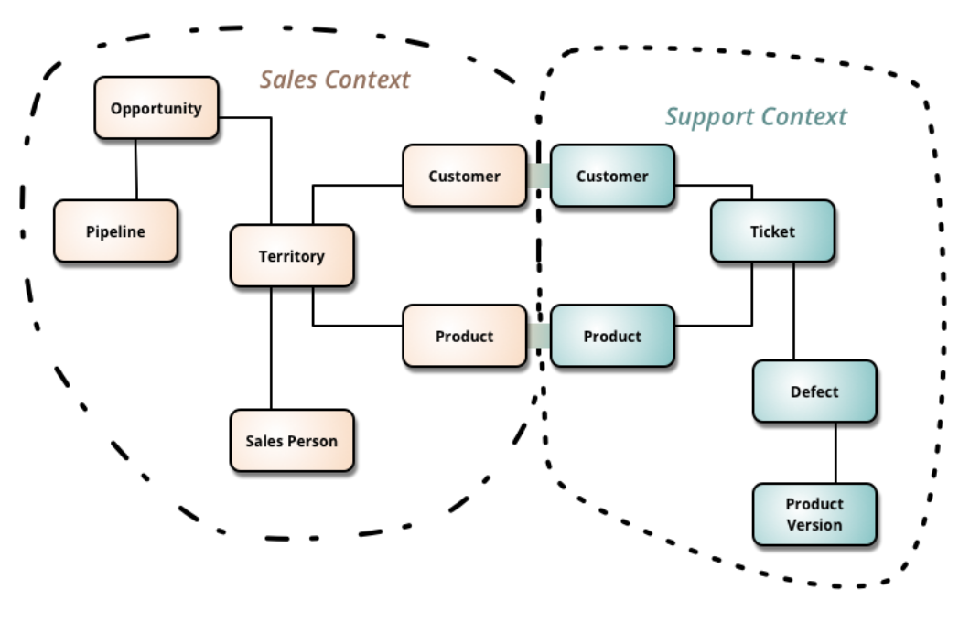
Context Map, Martin Fowler
https://martinfowler.com/bliki/BoundedContext.html
Context Map Example

Slide 21
Design Guidance:
Context Mapping
Documentation
Communication
Current State

Slide 22
Galactic Modeling Language
Box
Line
Label
Notes:
According to Kent Beck (http://wiki.c2.com/?GalacticModelingLanguage)

Slide 23
Context Map, Martin Fowler
https://martinfowler.com/bliki/BoundedContext.html
Context Map Example

Slide 24
Design Guidance
Context Mapping
Context Mapping
Context Mapping
Context Mapping
Minimalism
Minimalism
Minimalism
Minimalism
Design by Contract
Design by Contract
Design by Contract

Slide 25
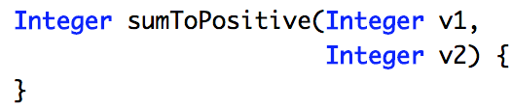
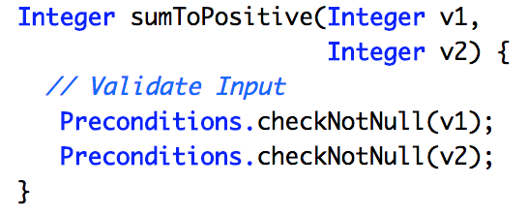
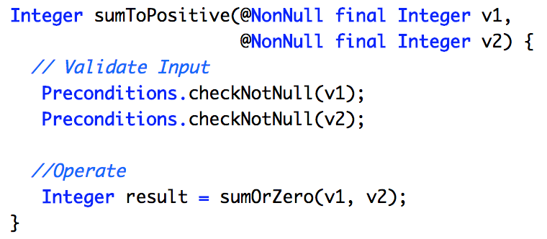
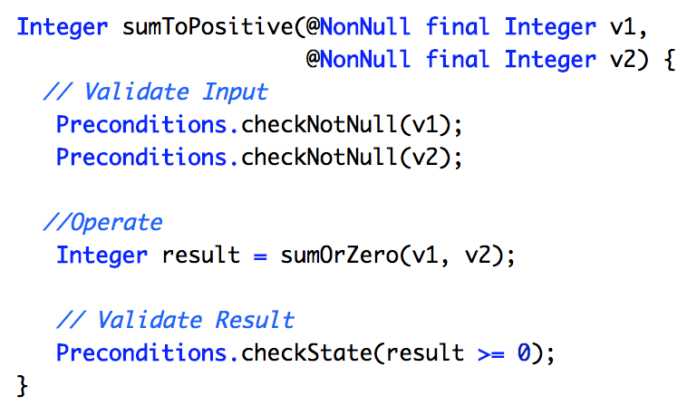
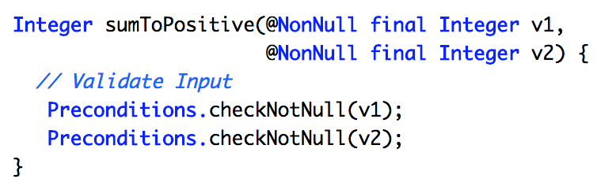
“Require No More,
Promise No Less”
Design by Contract
Design Guidance:
Design by Contract
Quote from Bertrand Meyer, “Design by Contract”

Slide 26
Domain Driven Design
One Size Fits All
Dogmatism
One Size Fits All
Context Matters
Context Matters
Context Matters
Context Matters
One Size Fits All
Dogmatism
Dogmatism
Guidance
Guidance
Design
Guidance
Design Guidance
No Pattern
Evolution
No Pattern
Evolution
No Pattern
Evolution
Pattern
Evolution
Design
Evolution
Design
Evolution
No Expiry Date
No Expiry Date
No Expiry Date
Expiration Date
Design Lifetime

Slide 27
Design Evolution
Supple Design
Strategic Decisions
Strategic Decisions

Slide 28
Design Evolution:
Supple Design
Immutable Operations
Declarative Design
Domain Specific Languages

Slide 29
Domain Specific Languages
Tailored to Domain
↑ Readability
Ubiquitous Language

Slide 30
Design Evolution
Supple Design
Supple Design
Strategic Decisions
Strategic Decisions
Strategic Decisions

Slide 31
Design Evolution:
Strategic Decisions
Team Collaboration
Absorbing Feedback
Experience Diversity

Slide 32
Domain Driven Design
One Size Fits All
Dogmatism
One Size Fits All
Context Matters
Context Matters
Context Matters
Context Matters
One Size Fits All
Dogmatism
Dogmatism
Guidance
Guidance
Guidance
Design
Guidance
No Pattern
Evolution
No Pattern
Evolution
Design
Evolution
No Pattern
Evolution
Pattern
Evolution
Design
Evolution
Design
Evolution
No Expiry Date
No Expiry Date
No Expiry Date
Expiration Date
Design Lifetime
Design Lifetime

Slide 33
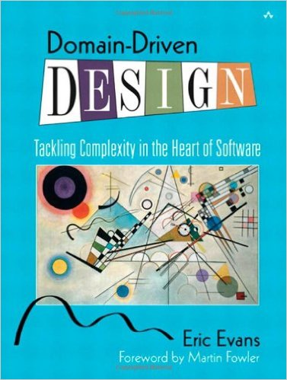
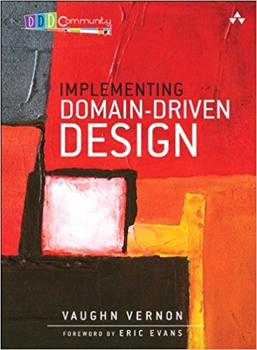
Design Lifetime:
Expiration Date
Expiration Date
10 years
2003
2013
Notes:
References:
https://www.amazon.com/Domain-Driven-Design-Tackling-Complexity-Software/dp/0321125215
https://www.amazon.com/Implementing-Domain-Driven-Design-Vaughn-Vernon/dp/0321834577/ref=pd_sim_14_2/146-5573393-8712768?_encoding=UTF8&pd_rd_i=0321834577&pd_rd_r=0HHESFRXFB5RETT0N0G9&pd_rd_w=V0P7D&pd_rd_wg=OozwD&psc=1&refRID=0HHESFRXFB5RETT0N0G9

Slide 34
Domain Driven Design
One Size Fits All
Dogmatism
One Size Fits All
Context Matters
Context Matters
Context Matters
Context Matters
Context Matters
One Size Fits All
Dogmatism
Dogmatism
Guidance
Guidance
Guidance
Design
Guidance
Design
Guidance
No Pattern
Evolution
No Pattern
Evolution
Design
Evolution
Design
Evolution
No Pattern
Evolution
Pattern
Evolution
Design
Evolution
Design
Evolution
No Expiry Date
No Expiry Date
No Expiry Date
Expiration Date
Expiration Date
Expiration Date
Design Lifetime
Design Lifetime
Design Lifetime

Slide 35
Let’s Step Back

Slide 36
Domain Driven Testing
Know What You’re Doing

Slide 37
Domain Driven Testing
as Design Principle

Slide 38
Looking back at DDD
Domain Driven Testing
Domain Driven Design
Context Mapping
Context Mapping
Context Mapping
Test Plan
Bound Context
Bound Context
Ubiquitous Language
Ubiquitous Language

Slide 39
Domain Driven Testing:
Context Mapping
Domain Driven Testing:
Test Plan

Slide 40
Context Map, Martin Fowler
https://martinfowler.com/bliki/BoundedContext.html
Context Map Example

Slide 41
Domain Driven Testing
Context Mapping
Context Mapping
Context Mapping
Test Plan
Test Plan
Bound Context
Bound Context
Bound Context
Test Structure
Ubiquitous Language
Ubiquitous Language

Slide 42
Domain Driven Testing:
Test Structure
Domain Driven Testing:
Bound Context
Production Entities
Test Entities

Slide 43
Domain Driven Testing
Context Mapping
Context Mapping
Context Mapping
Test Plan
Test Plan
Bound Context
Bound Context
Bound Context
Test Structure
Test Structure
Ubiquitous Language
Ubiquitous Language
Ubiquitous Language
Test Cases

Slide 44
Domain Driven Testing:
Ubiquitous Language
Domain Driven Testing:
Test Cases

Slide 45
Let’s get more Practice
Enough Theory!

Slide 46
How do we usually test?

Slide 47
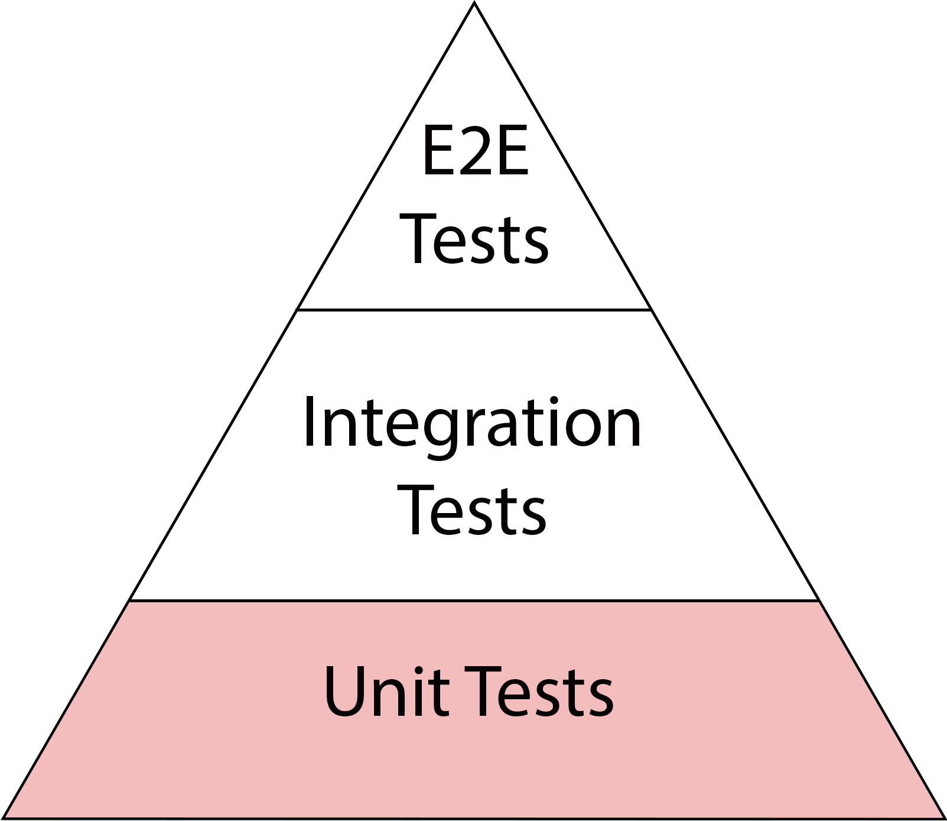
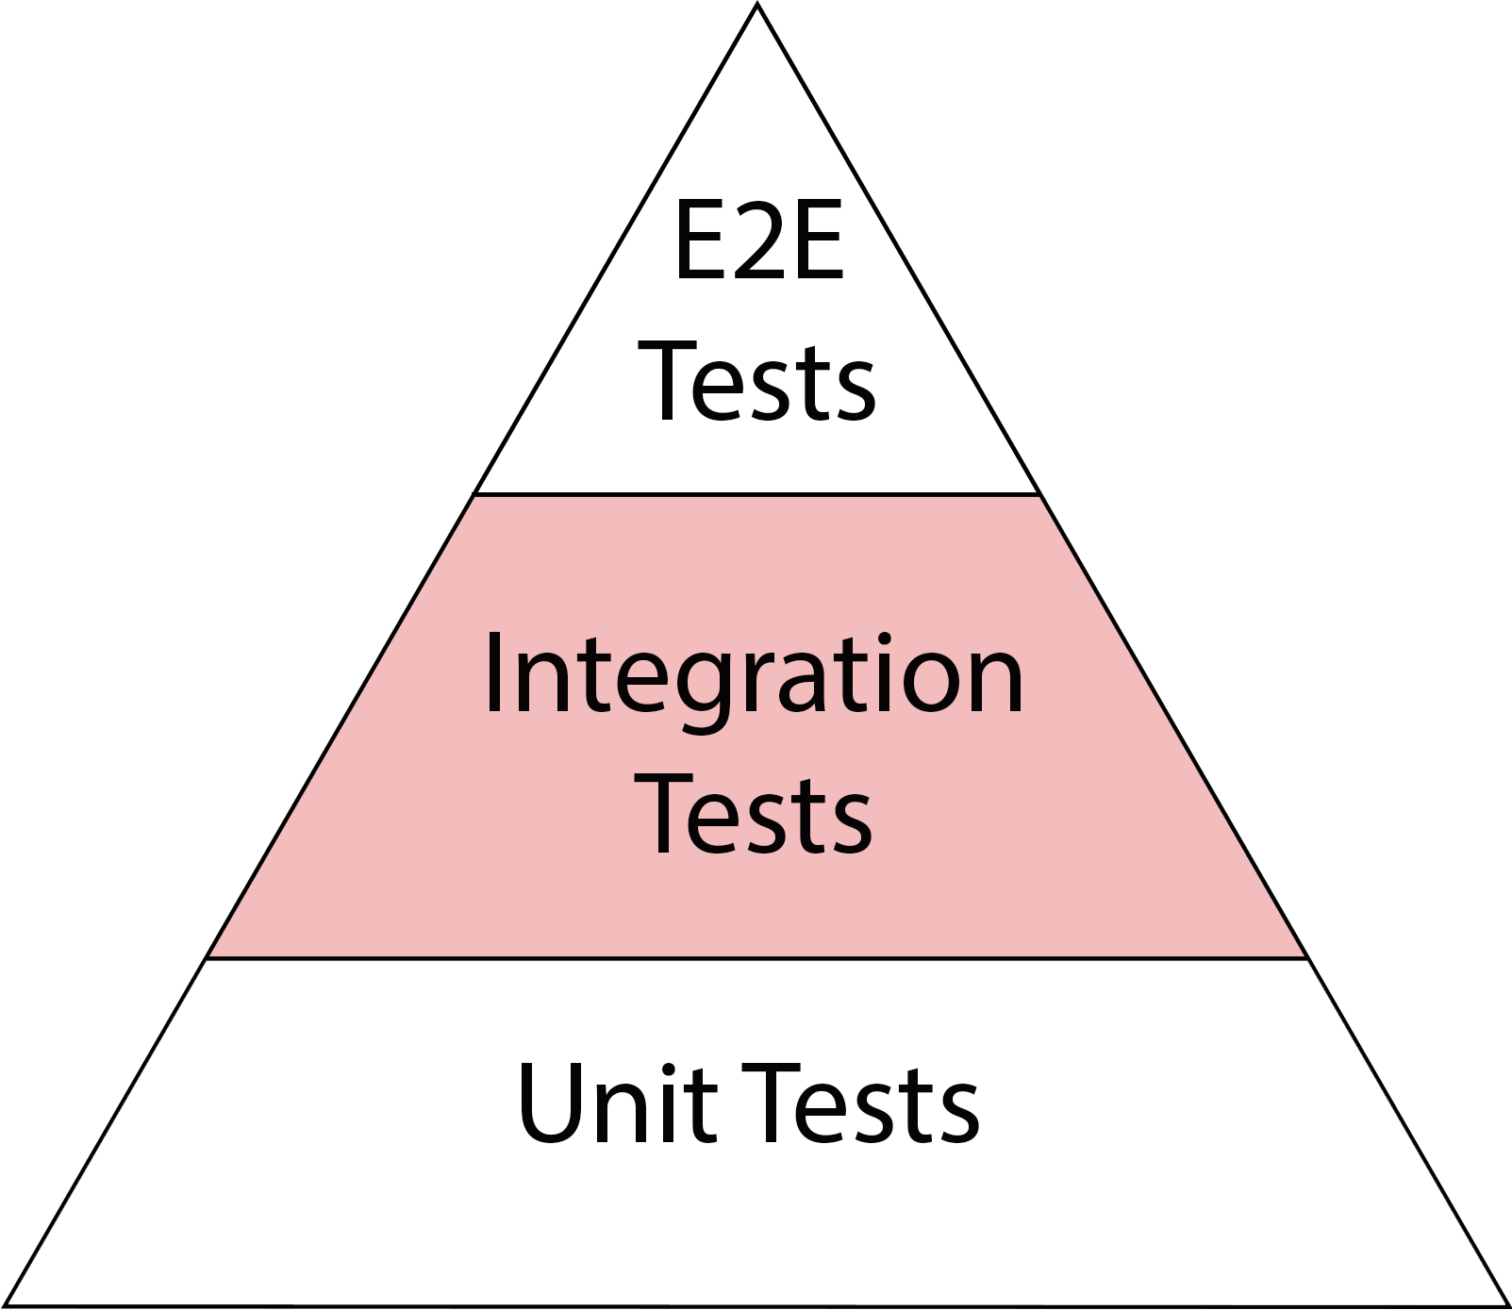
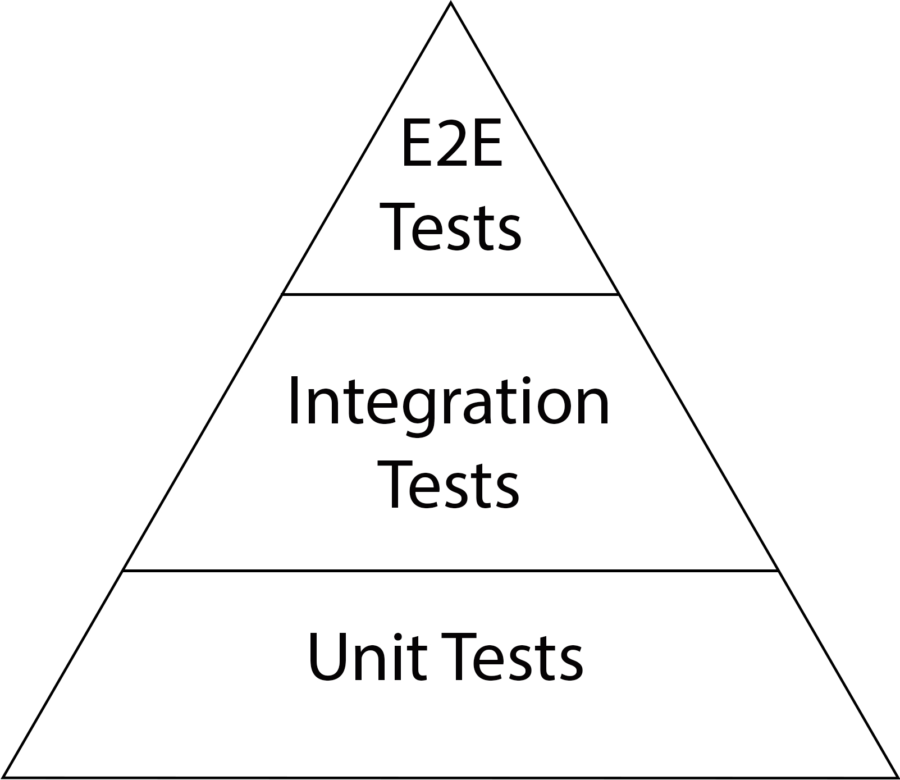
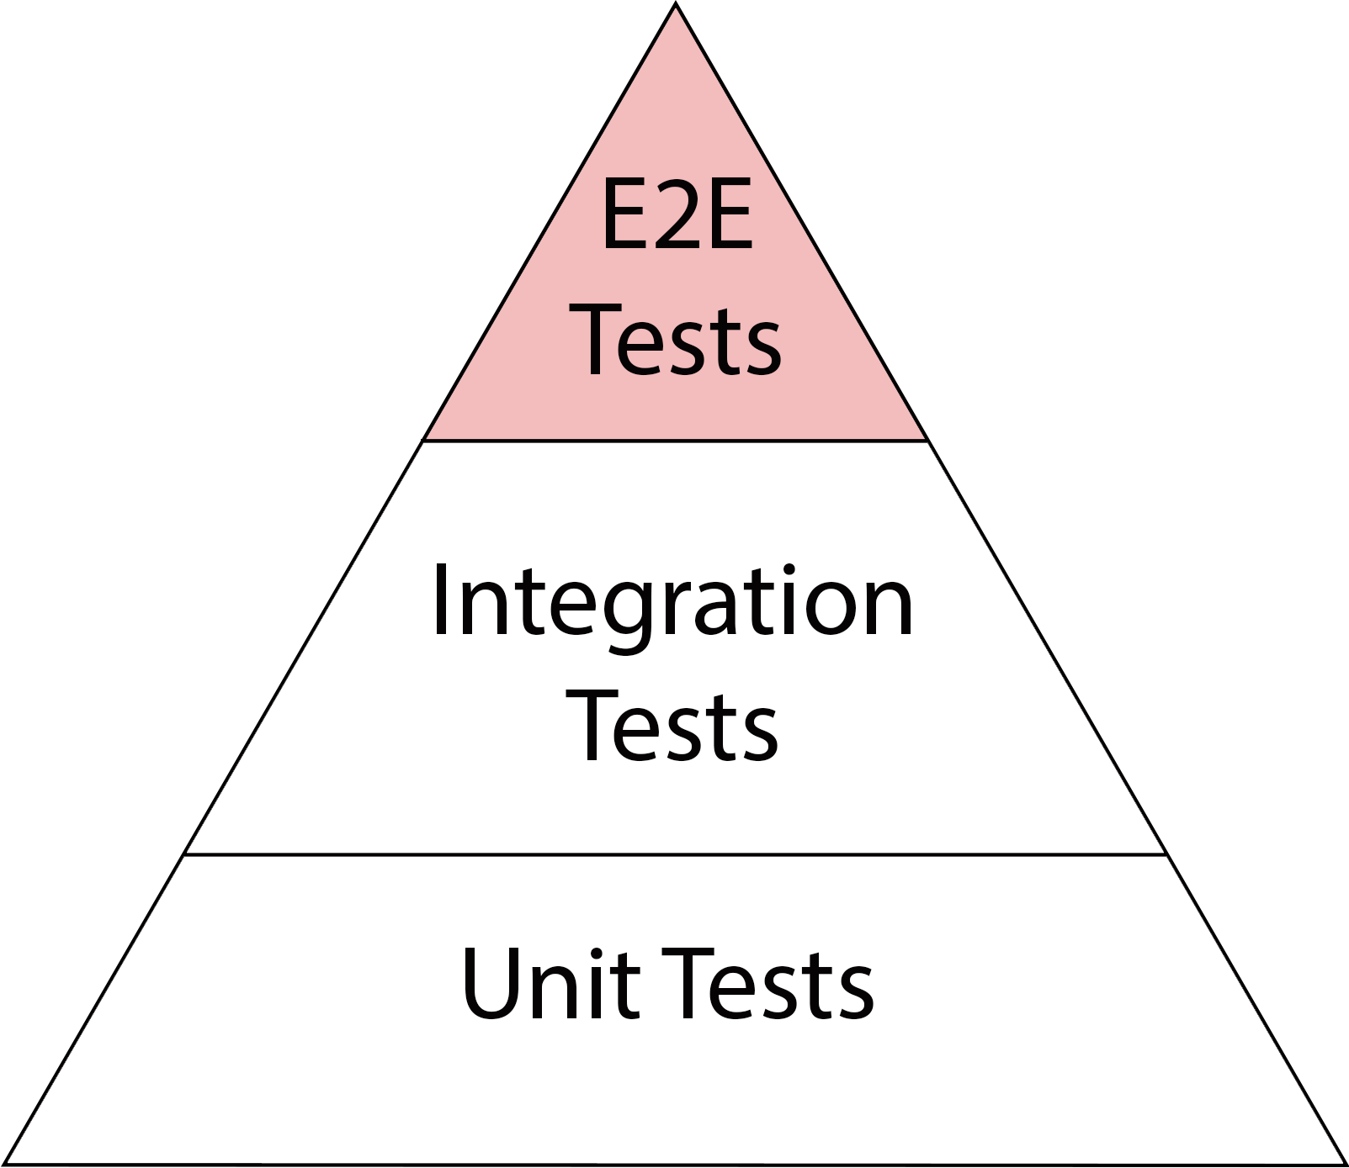
Test Pyramid
↑ Fidelity
↓ Speed
↑ Cost
↓ Fidelity
↑ Speed
↓ Cost

Slide 48
Let’s Put DDD Spin on It

Slide 49
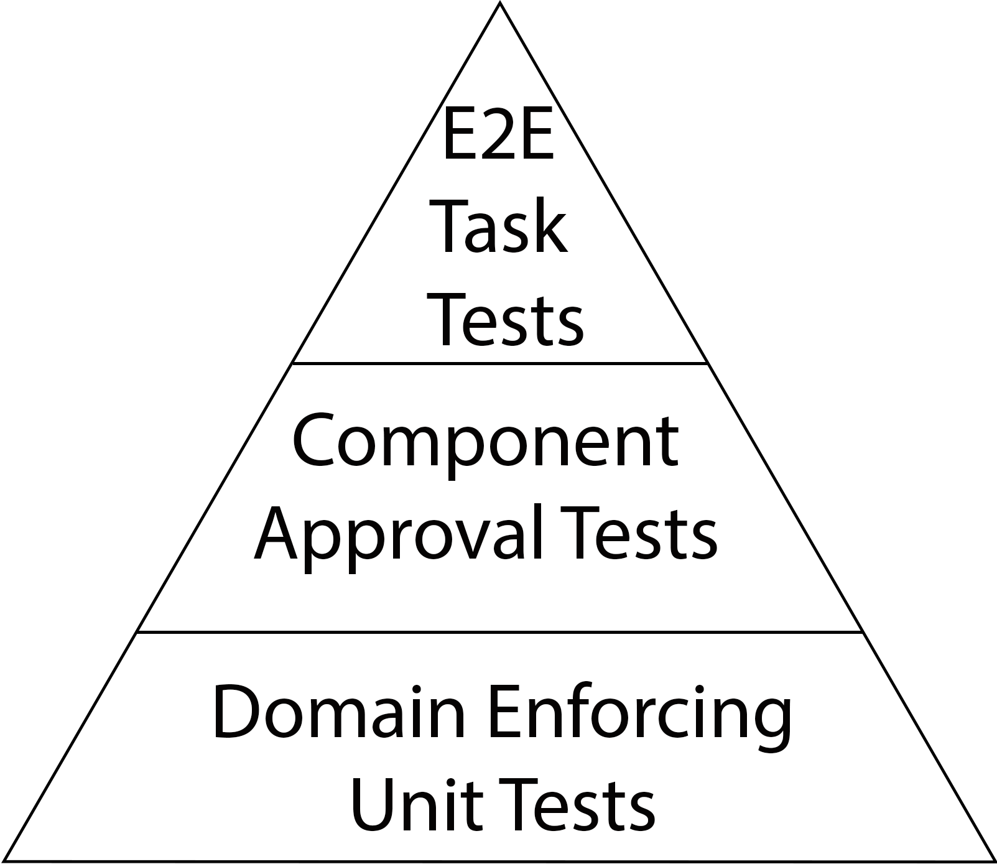
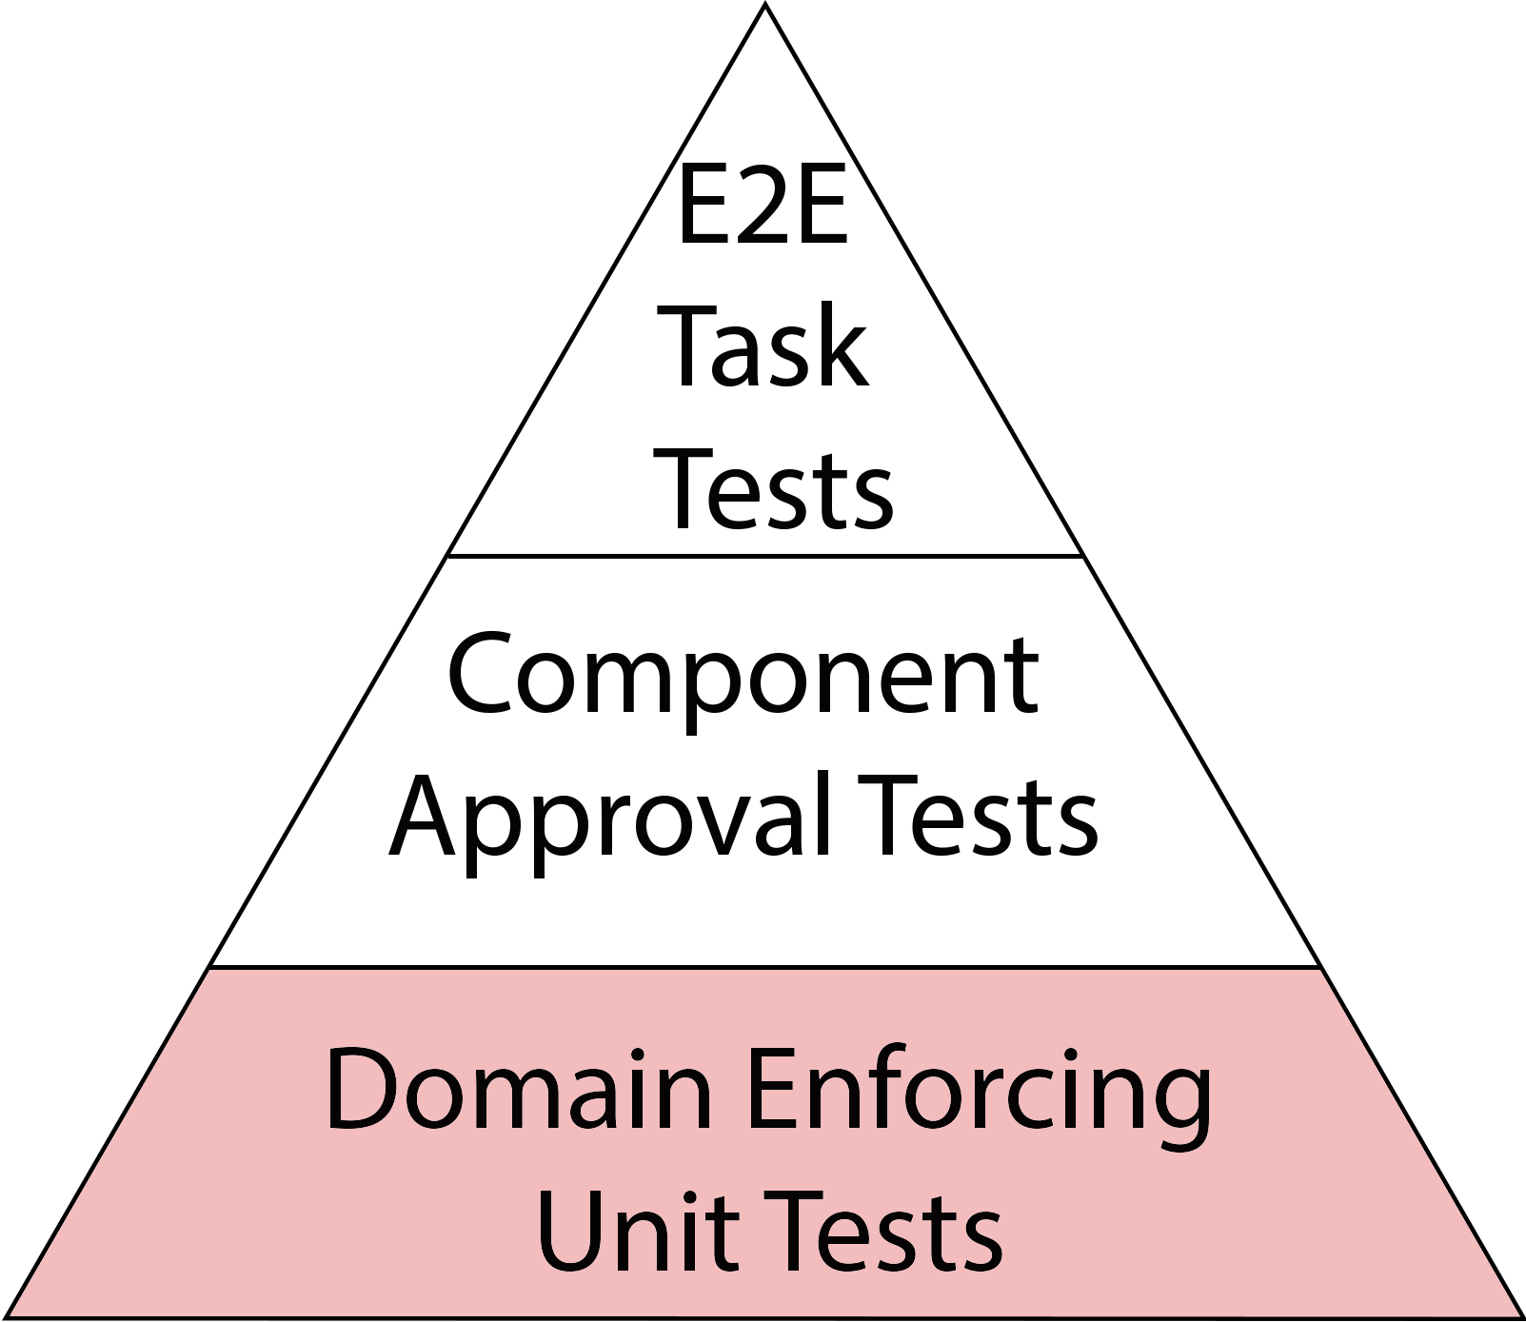
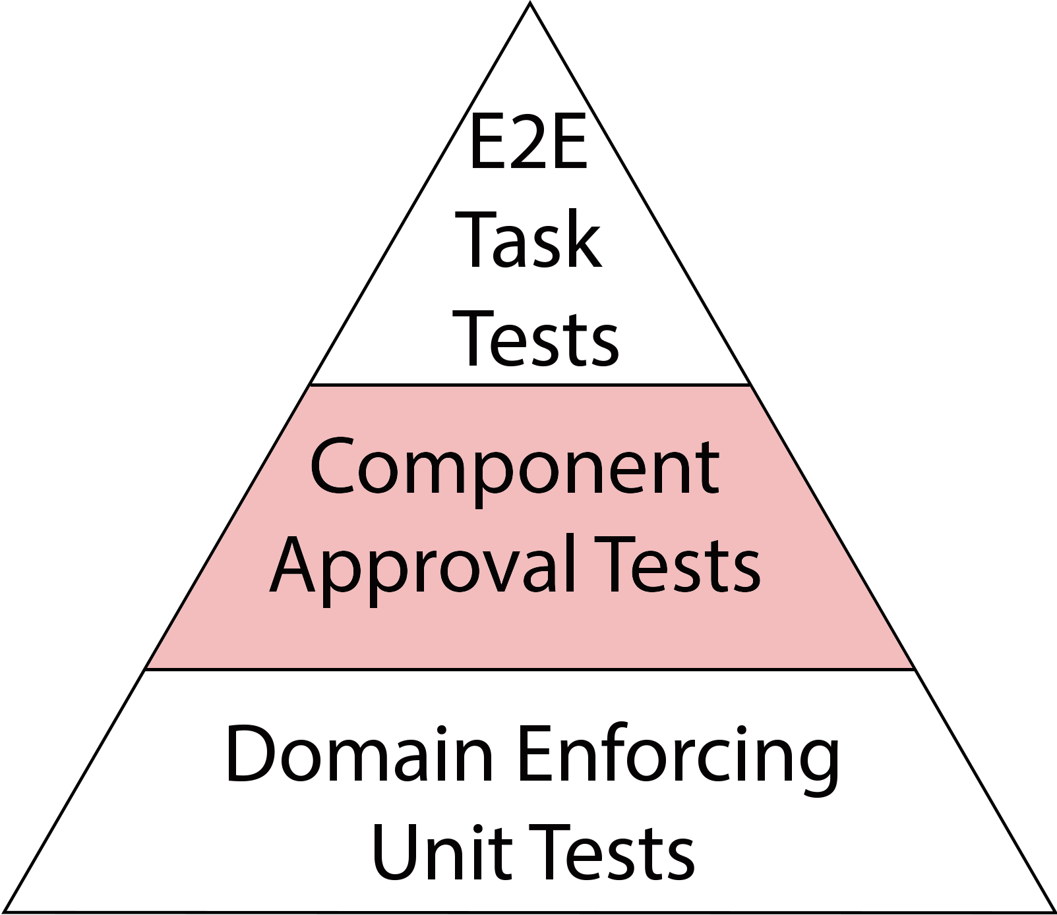
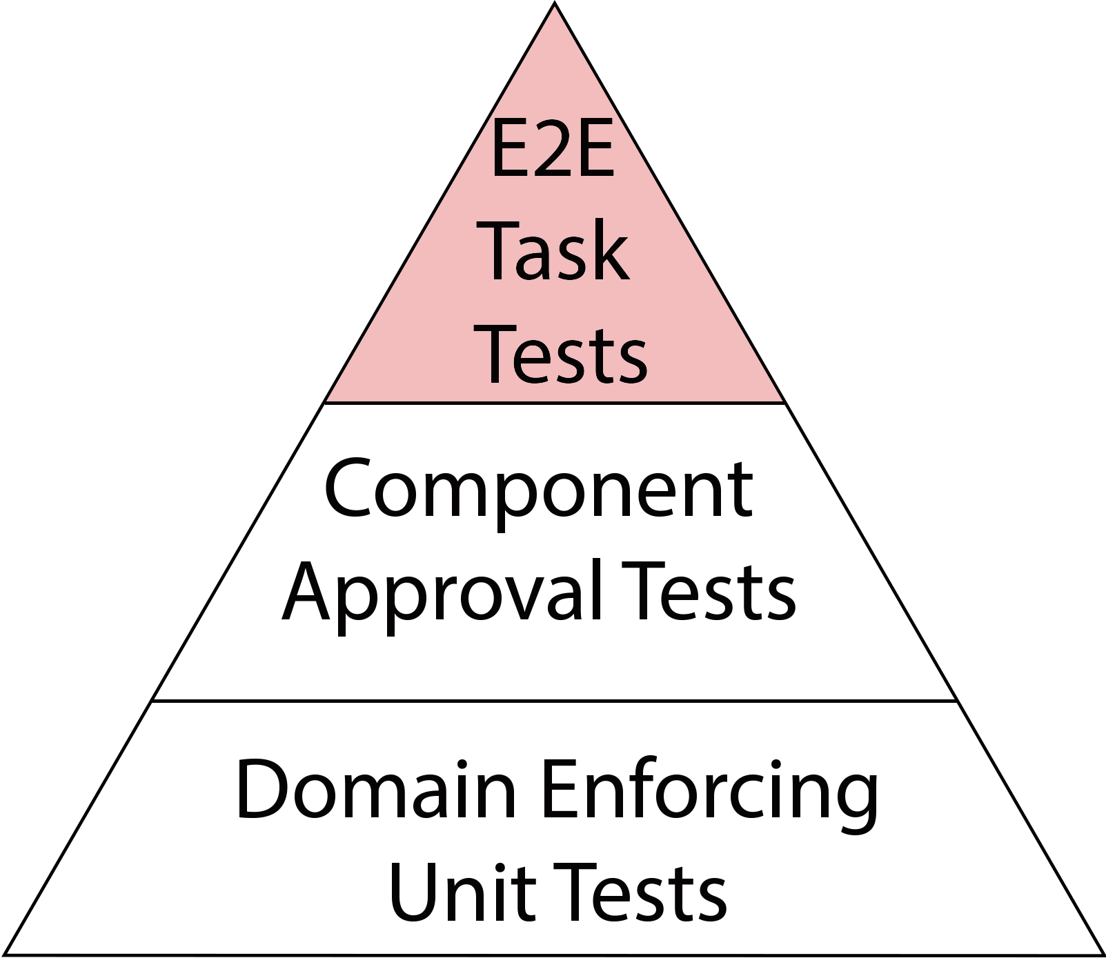
DDD Test Pyramid
Test Pyramid
↑ Fidelity
↓ Speed
↑ Cost
↓ Fidelity
↑ Speed
↓ Cost

Slide 50
Domain Enforcing
Unit Tests
Tests as Auditor
Last Day Style
Invariants Approval Testing

Slide 51
Approval Testing
What is
Approval Testing?
Evolving Validation
Requirements
Driven
↑ Fidelity
↑ Cost

Slide 52
Back to Domain Enforcing Unit Tests
Property Based Testing
QuickTheory
Invariants Approval Testing
Schema Based Testing
Schema Based Testing
JSON Schema Validator
JSON Schema Validator

Slide 53
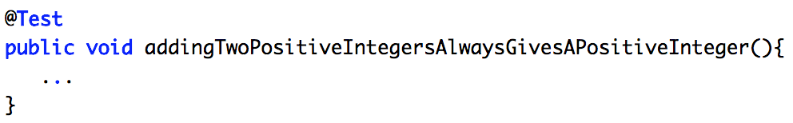
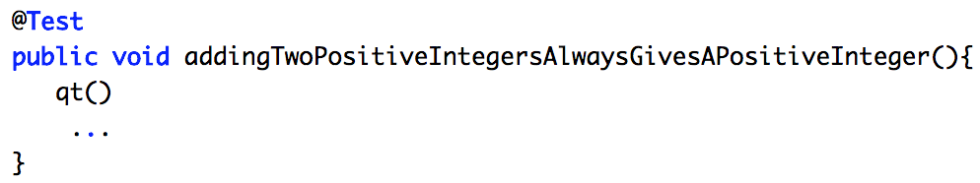
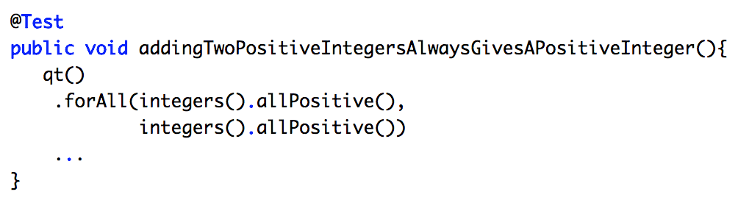
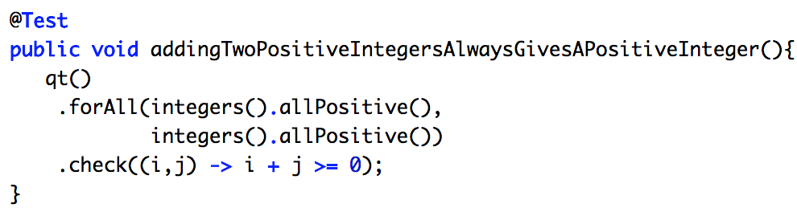
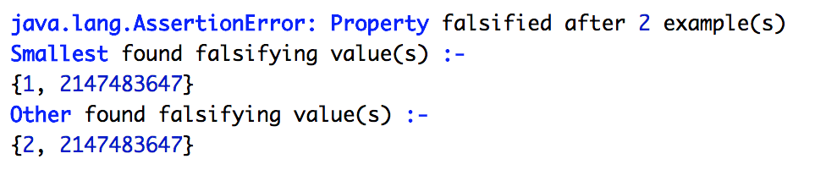
QuickTheory

Slide 54
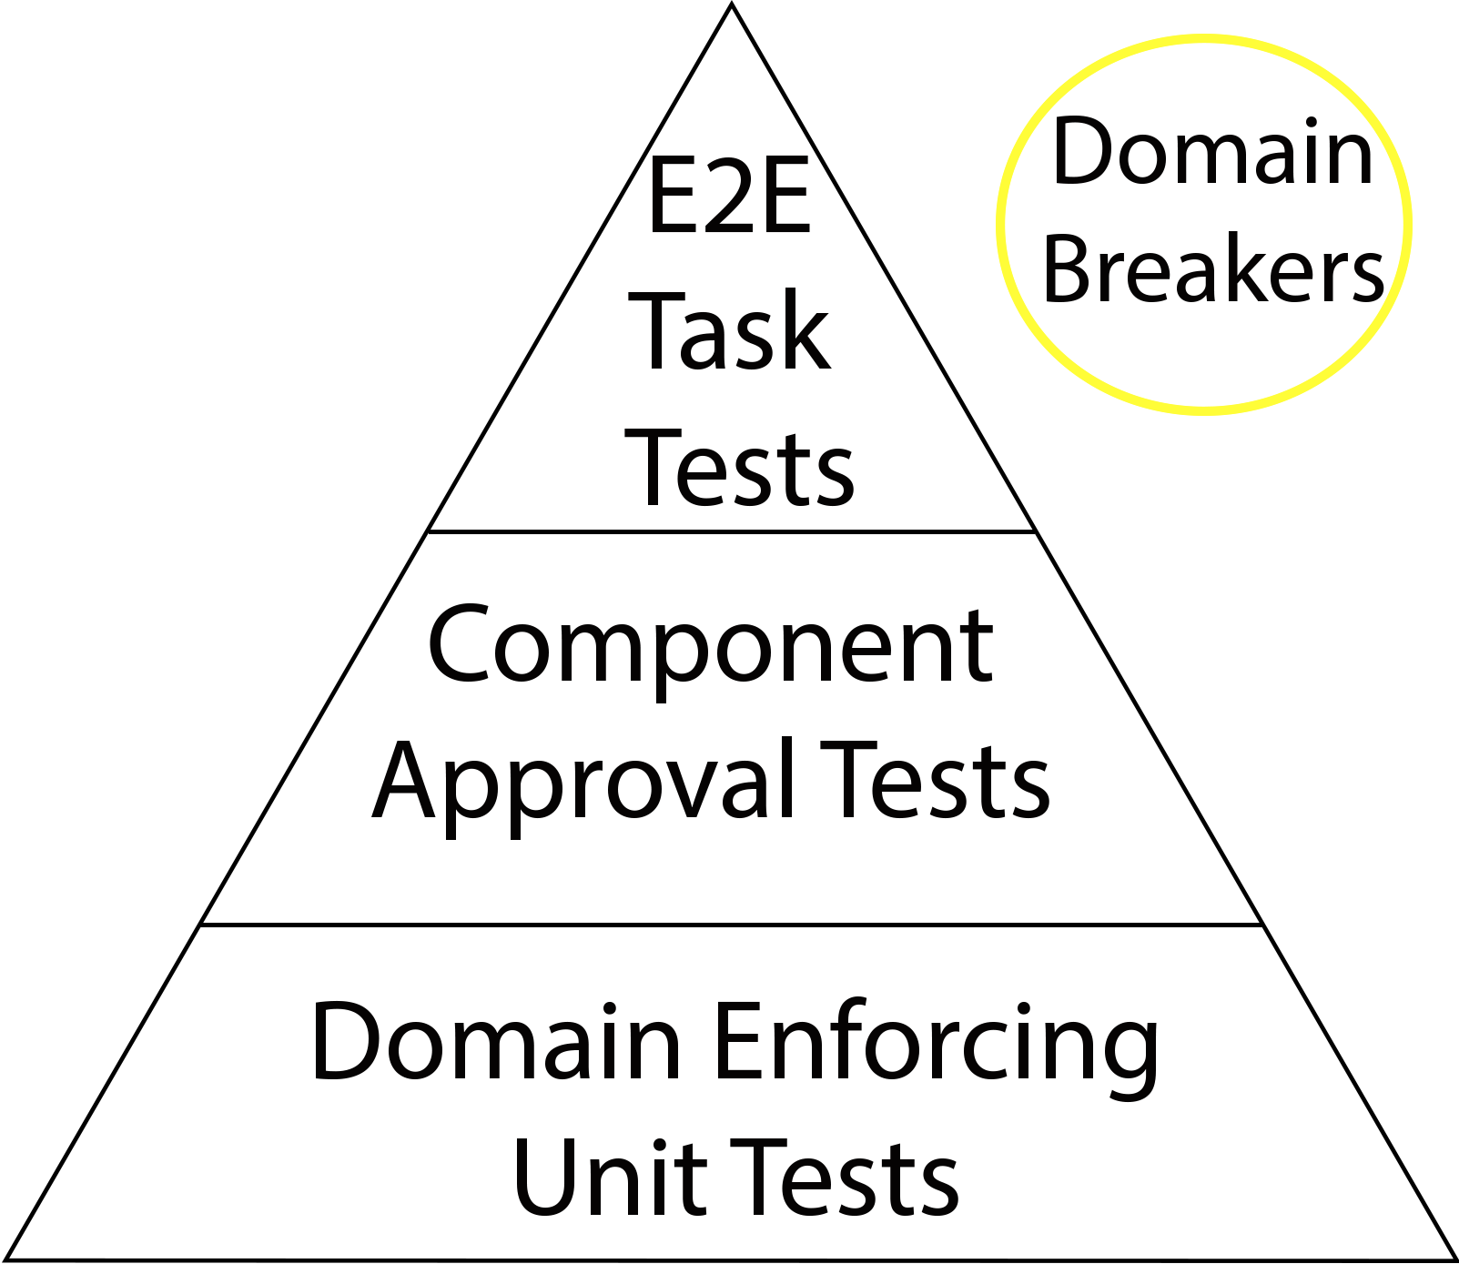
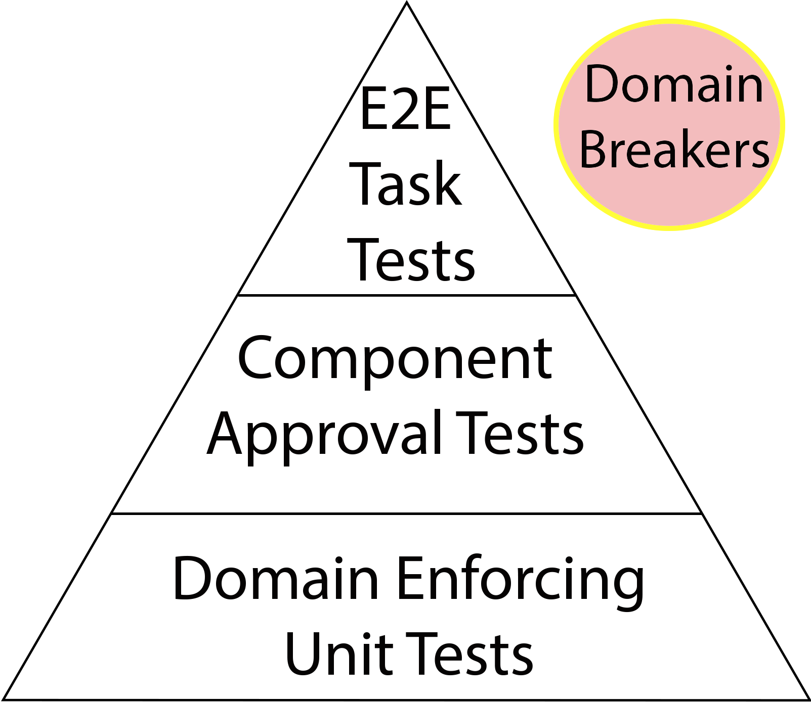
DDD Test Pyramid
↓ Fidelity
↑ Speed
↓ Cost

Slide 55
Component
Approval Testing
Text Based Testing
TextTest
TextTest
Snapshot Testing
Snapshot Testing
Snapshot Testing
Jest
Jest
Visual Testing
Visual Testing
Visual Testing
Applitools
BackstopJS

Slide 56
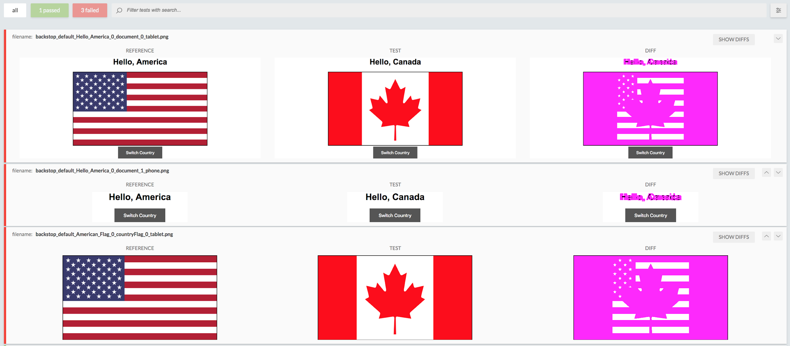
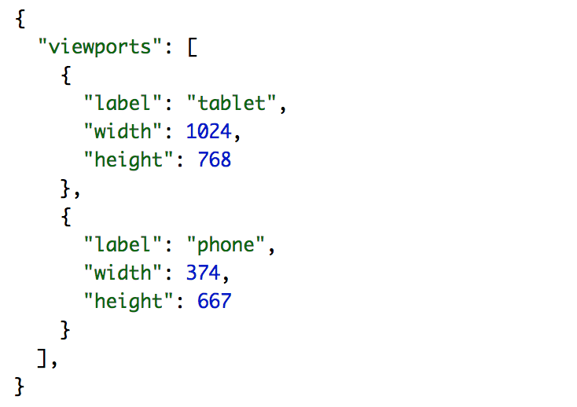
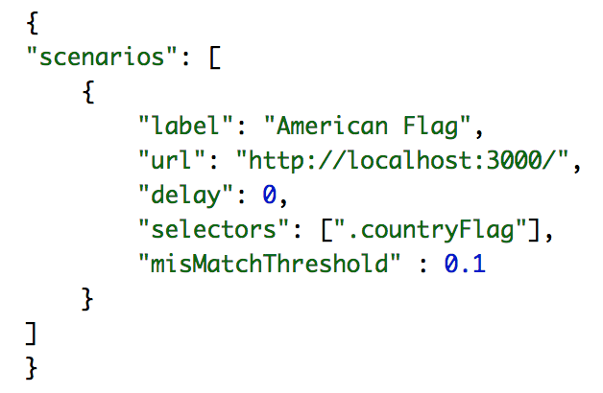

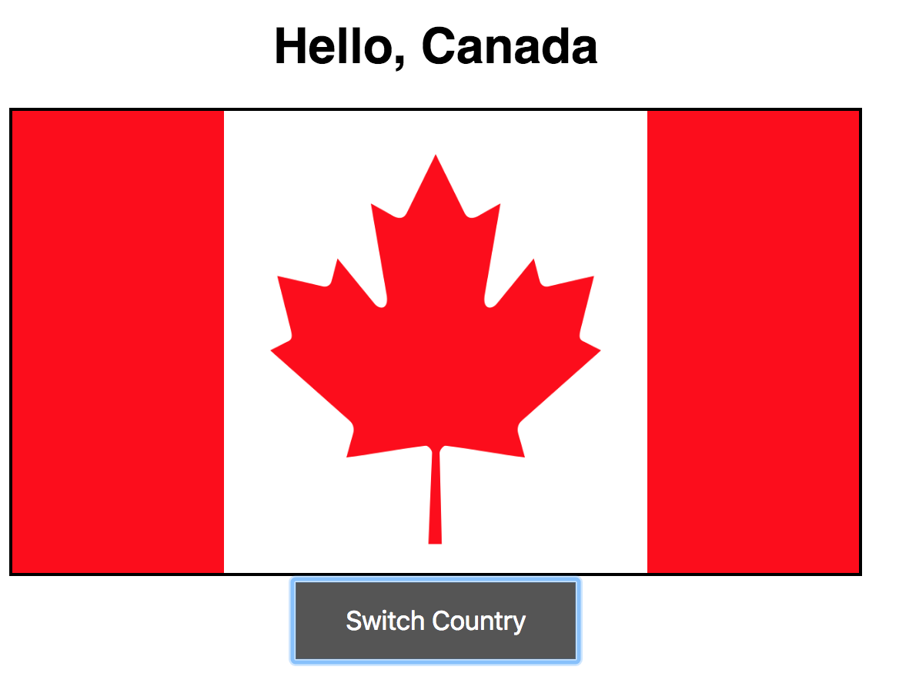
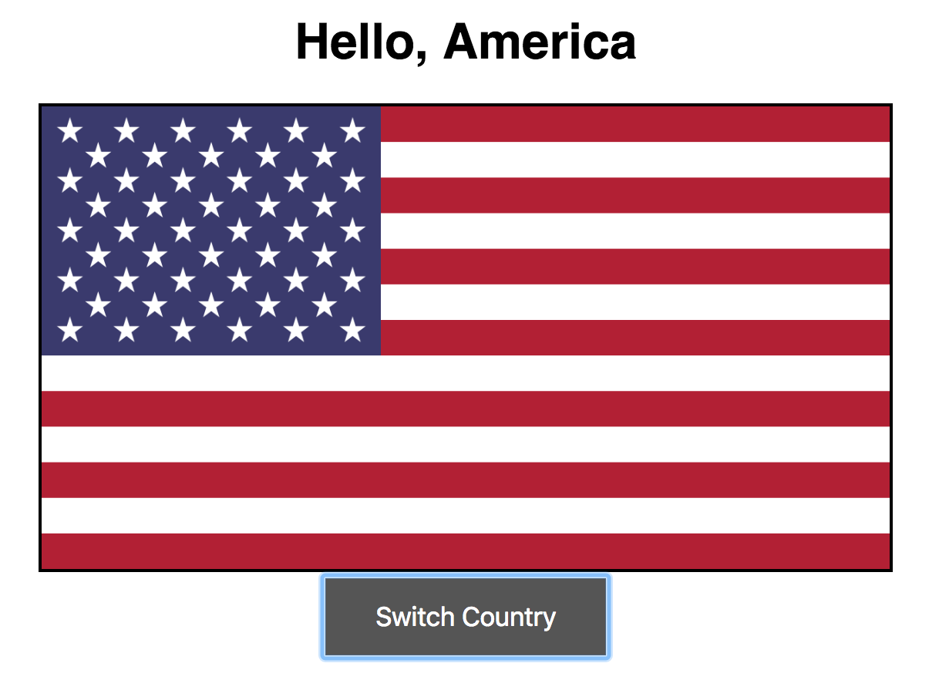
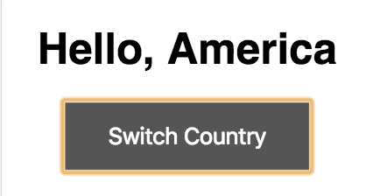
BackstopJS

Slide 57
DDD Test Pyramid
↑ Fidelity
↓ Speed
↑ Cost
↓ Fidelity
↑ Speed
↓ Cost

Slide 58
End-to-End Task Testing
User Centric Testing
Interactions
Tasks
Page Object Model
Screenplay Pattern

Slide 59
Focus on User Dimension
Conclusion

Slide 60
User Dimensions
Web User
Client Side
Protractor
API User
RestAssured
Server Side

Slide 61
DDD Test Pyramid
↑ Fidelity
↓ Speed
↑ Cost
↓ Fidelity
↑ Speed
↓ Cost

Slide 62
How to find flaws in DDT?
Experiment!

Slide 63
Domain Breakers
Outsiders
Exploratory Testing
Chaos Testing
Fuzzing Testing

Slide 64
Bringing it all together
There is a place for Design in Testing!
Place for
Domain Driven Design

Slide 65
Call For Action
Evaluate Test Architecture
Create Context Boundaries
Unify Test Strategy
Experiment!

Slide 66
Q/A

Slide 67
About Speaker
Twitter: @DmitryVinnik
LinkedIn: in/dmitry-vinnik/
Email: dmitry@dvinnik.com

